Slide 1
Security Framework
Ryan Coon
CYB-690
Dr. Kim Ford
September 10, 2025

Slide 2
Contents
Current Cybersecurity Environment
Framework Descriptions
Security Best Practices and Frameworks
Common Workflow of Information and Decisions Diagram
Critical Cybersecurity Needs
Elements of a Software Assurance Maturity Model

Slide 3
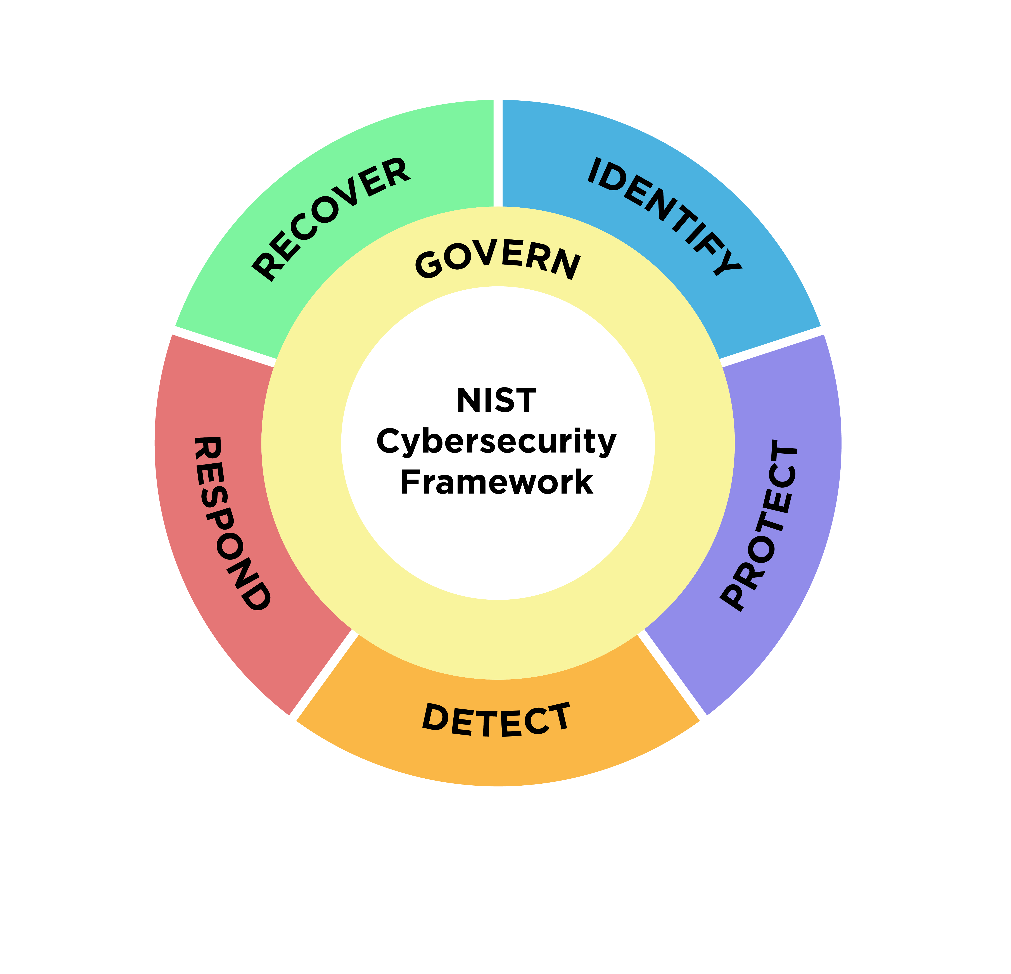
Current Cybersecurity Environment

Slide 4
Current Cybersecurity Environment
Development Processes & Paradigms
RC Cybersecurity employs DevSecOps principles, integrating security practices throughout the entire software development lifecycle (SDLC). This paradigm shift moves security from a late-stage gatekeeper to an embedded, continuous concern. Development processes are iterative and agile, with security checks and automated testing like SAST, DAST, IAST, incorporated into CI/CD pipelines. The overarching paradigm is one of risk-based security, where resources and efforts are prioritized based on identified threats and vulnerabilities impacting critical services.

Slide 5
Current Cybersecurity Environment
Information Management
Information management at RC Cybersecurity is crucial for understanding and protecting its assets. This involves robust data classification, inventorying of all digital assets (hardware, software, data), and implementing controls for data access, transmission, and storage. The CSF 2.0's Govern function is paramount here, ensuring policies and procedures are in place for information handling, privacy, and regulatory compliance. This includes managing sensitive customer data, intellectual property, and operational information

Slide 6
Current Cybersecurity Environment
Configuration Management
Effective configuration management is vital for maintaining the integrity and security posture of RC Cybersecurity's systems. This entails establishing and maintaining secure baseline configurations for all hardware and software, employing automated tools for configuration monitoring and drift detection, and implementing strict change control processes. The CSF 2.0's Protect function directly addresses this, focusing on safeguards to ensure the confidentiality, integrity, and availability of information and systems. This includes vulnerability management, access control, and endpoint security.

Slide 7
Current Cybersecurity Environment
Systems Involved in Service Delivery
The systems directly involved in RC Cybersecurity's service delivery are diverse and interconnected. These typically include:
Cloud Infrastructure - For hosting applications and data, requiring robust identity and access management (IAM), network segmentation, and cloud security posture management (CSPM).
Customer-Facing Applications - Web portals, APIs, and client software that require secure coding practices, regular vulnerability scanning, and protection against common web attacks as noted on the OWASP Top 10.
Internal Operations Systems - CRM, ticketing systems, collaboration tools, and monitoring platforms that, while internal, are critical for service operations and require strong access controls and data protection.
Network Infrastructure - Firewalls, routers, switches, and VPNs that form the backbone of service delivery and must be secured, monitored, and patched.
Identity and Access Management (IAM) Systems - Central to controlling who can access what, these systems are critical for the Identify and Protect functions of the CSF.

Slide 8
Framework Descriptions
The NIST Cybersecurity Framework (CSF) 2.0 serves as a pivotal guide for RC Cybersecurity's risk management practices. This framework emphasizes a holistic approach, starting with business/mission objectives to ensure cybersecurity efforts directly support the company's core goals. For RC Cybersecurity, this means aligning security investments and strategies with the delivery of its services and overall business strategy.

Slide 9
Framework Descriptions
Risk Management Practices under CSF 2.0 are structured around five core functions: Identify, Protect, Detect, Respond, and Recover. RC Cybersecurity would leverage these to understand its assets, implement safeguards, detect malicious activity, and effectively respond to and recover from incidents. This framework encourages a continuous cycle of improvement, adapting to the evolving threat landscape.
Regarding development threats, CSF 2.0 places a new emphasis on supply chain risk management and secure software development. RC Cybersecurity would need to integrate security considerations throughout its Software Development Lifecycle (SDLC), addressing threats such as code vulnerabilities, compromised third-party components, and insecure deployment practices. The framework provides guidance on how to identify and mitigate these risks.

Slide 10
Framework Descriptions
Legal and regulatory requirements are a critical input into the risk management process. RC Cybersecurity must ensure its practices comply with relevant laws and industry-specific regulations like data privacy laws, sector-specific compliance mandates. CSF 2.0's flexibility allows organizations to map its controls and practices to these external requirements, ensuring a compliant yet effective security posture.
Organizational constraints are also a key consideration. These can include budget limitations, available personnel expertise, existing technological infrastructure, and the overall organizational culture. CSF 2.0 acknowledges these constraints by being a flexible, customizable framework. RC Cybersecurity can tailor its implementation of the framework to fit its specific operational realities, prioritizing the most impactful controls based on its unique risk profile and available resources. The framework's tiered approach (Implementation Tiers) also helps organizations understand their current cybersecurity maturity and plan for incremental improvements, respecting these constraints.

Slide 11
Security Best Practices and Frameworks
Security best practices and frameworks serve as invaluable blueprints for constructing a comprehensive cybersecurity program at RC Cybersecurity. By adopting a recognized framework, such as the NIST Cybersecurity Framework (CSF) 2.0, RC Cybersecurity gains a structured and systematic approach to managing cybersecurity risk.

Slide 12
Security Best Practices and Frameworks
Leveraging Frameworks for Program Development:
Foundation and Structure - Frameworks like NIST CSF 2.0 provide a common language and a set of core functions and categories. This offers a clear roadmap for organizing and prioritizing cybersecurity activities, ensuring all critical areas are addressed.
Risk-Based Approach - These frameworks promote a risk-based methodology. RC Cybersecurity can use them to identify its most critical assets, potential threats, and vulnerabilities, then tailor its security controls and investments to address the highest risks first. This ensures resources are allocated efficiently.
Best Practice Integration - Frameworks are essentially curated collections of industry best practices. By adhering to them, RC Cybersecurity automatically incorporates proven methods for areas like access control, data protection, incident response planning, and continuous monitoring.
Scalability and Adaptability - Recognized frameworks are designed to be adaptable to organizations of all sizes and complexities. RC Cybersecurity can implement the framework at a maturity level that suits its current capabilities and scale its program as it grows and its threat landscape evolves.
Compliance and Assurance - Frameworks often align with various legal and regulatory requirements. Using a framework like NIST CSF 2.0 can help RC Cybersecurity demonstrate compliance and provide assurance to stakeholders that its cybersecurity program is robust and well-managed.
Workforce Development - Frameworks like the NICE Workforce Framework for Cybersecurity can guide RC Cybersecurity in identifying necessary skills, roles, and training for its cybersecurity team, ensuring it has the right talent to execute the program.

Slide 13
Security Best Practices and Frameworks
Key Elements to Consider:
Identify - Understanding the business environment, assets, and risks.
Protect - Implementing safeguards for critical services and data.
Detect - Developing capabilities to identify cybersecurity events.
Respond - Establishing plans and procedures for handling detected events.
Recover - Ensuring resilience and restoring capabilities after an incident.
By consistently referencing and implementing these frameworks and best practices, RC Cybersecurity can build a dynamic, effective, and resilient cybersecurity program that proactively defends against threats and supports its business objectives.

Slide 14
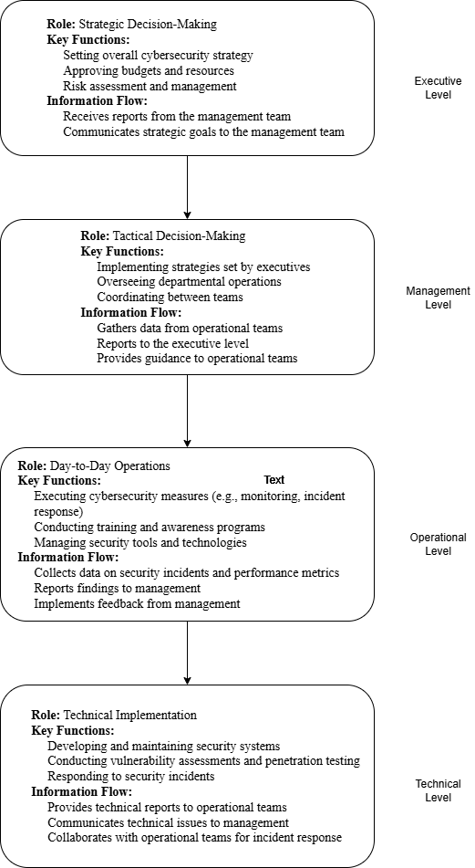
Common Workflow of Information and Decisions Diagram

Slide 15
Critical Cybersecurity Needs
RC Cybersecurity's critical needs for regulatory compliance are multifaceted, requiring a tailored approach that extends beyond general frameworks like NIST and ISO/IEC 27000-series.
NIST Cybersecurity Framework (CSF) provides a comprehensive, risk-based approach to cybersecurity management. It offers a flexible structure applicable across industries, focusing on core functions: Identify, Protect, Detect, Respond, and Recover. While foundational, it's often a baseline.
ISO/IEC 27000-series, particularly ISO 27001, establishes requirements for an Information Security Management System (ISMS). It emphasizes a systematic approach to managing sensitive company information, focusing on risk assessment, policies, and continuous improvement of the ISMS.

Slide 16
Critical Cybersecurity Needs
Prioritizing Organizational Efforts, Business Needs, and Outcomes:
Identify Core Business Objectives: What are RC Cybersecurity's primary services and mission? Align cybersecurity efforts directly with protecting these core functions.
Regulatory Mapping: Determine which regulations are most applicable based on RC Cybersecurity's operations and data handling. Map specific regulatory requirements to the NIST CSF functions or ISO 27001 controls.
Risk Assessment: Conduct a thorough risk assessment to identify the most significant threats and vulnerabilities, considering the specific data types handled (e.g., cardholder data, PHI, financial data) and the regulatory impact of a breach.

Slide 17
Critical Cybersecurity Needs
Prioritize Controls: Based on the risk assessment and regulatory mapping, prioritize the implementation of controls that address the highest risks and most critical compliance requirements. For example:
If handling payment data, PCI DSS controls for cardholder data protection would be paramount.
If handling health data, HIPAA's technical and administrative safeguards for PHI would take precedence.
For financial reporting, SOX-related controls ensuring data integrity are critical.
Leverage Frameworks: Use NIST CSF and ISO 27001 as overarching management systems to ensure a structured, continuous approach. These frameworks help organize the implementation of specific controls required by PCI DSS, HIPAA, SOX, and GLBA.
Continuous Monitoring and Improvement: Establish processes for ongoing monitoring of compliance and security posture, and for continuously improving the cybersecurity program based on new threats, regulatory changes, and business needs.

Slide 18
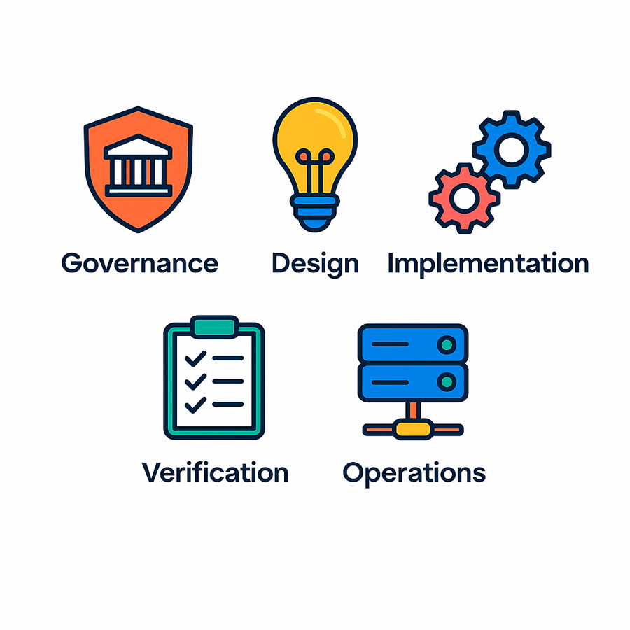
Elements of Software Assurance Maturity Model
The current model is based on a collection of 15 security practices organized into five major business functions. Governance, design, implementation, verification, and operations are all part of the process.
Governance - The governance chapter focuses on key performance indicators (KPIs), which allow teams to see if they have made the desired progress and where intervention is necessary. It also addresses project policy and compliance, as well as third-party component suppliers.
Design- In the design phase, security activities include establishing security requirements, developing a security architecture, and undertaking threat modeling. The purpose is to determine which dangers are influencing the application under development and whether they are being dealt with effectively.

Slide 19
Elements of Software Assurance Maturity Model
Implementation - SAMM focuses on the tools for integrating security into the build and deployment processes in this chapter. Issues concern the secure processing of credentials to reduce human participation during initial setup and future secret renewal. While critical throughout the development lifecycle, defect control is also addressed in implementation concerns.
Verification - In many sectors, releasing software into production without first ensuring its quality has become inconceivable. This is especially true for security checks. The chapter proposes security checks based on concrete security requirements, while generic tests are still justified. SAMM prioritizes denial of service benchmarks, fuzzing, regression testing for resolved vulnerabilities, and test automation during the build and deployment process.
Operation - With DevOps, the boundaries of the software development process are increasingly beginning to blur. The maturity model adds a separate section for operation. The specifications tolerate manual log analysis, ad hoc responses to incidents, and best efforts to detect attacks at a low maturity level. Improved maturity requires a dedicated incident response team and defined processes for the detection and remediation of incidents.

Slide 20
References
exabeam. (2022, November 12). Information Security: Goals, Types and Applications. Exabeam.
https://www.exabeam.com/explainers/information-security/information-security-goals-types-and-applications/
Kirvan, P., & Granneman, J. (2023, October 27). Top 7 IT security frameworks and standards explained. SearchSecurity.
https://www.techtarget.com/searchsecurity/tip/IT-security-frameworks-and-standards-Choosing-the-right-one
Montauban, N. (2025, April 4). OWASP SAMM: A Comprehensive Introduction. Codific. https://codific.com/owasp-samm-comprehensive-introduction/
Morrison, A. (2025). Invensis Inc. Invensis.net. https://www.invensis.net/blog/key-cybersecurity-standards
NIST. (2024). The NIST cybersecurity framework (CSF) 2.0. The NIST Cybersecurity Framework (CSF) 2.0, 2.0(29). https://doi.org/10.6028/nist.cswp.29
Rohland, J. (2025). NIST Releases Updated Cybersecurity Framework 2.0 | EDCi. Edci.com. https://www.edci.com/blog-posts/nist-releases-updated-cybersecurity-framework-version-2-0

